Slide 1
The Byzantine Generals Problem
Lecturer: Ngo Huy Bien
Software Engineering Department
Faculty of Information Technology
VNUHCM - University of Science
Ho Chi Minh City, Vietnam
nhbien@fit.hcmus.edu.vn

Slide 2

Objectives

Slide 3

Contents

Slide 4

References

Slide 5
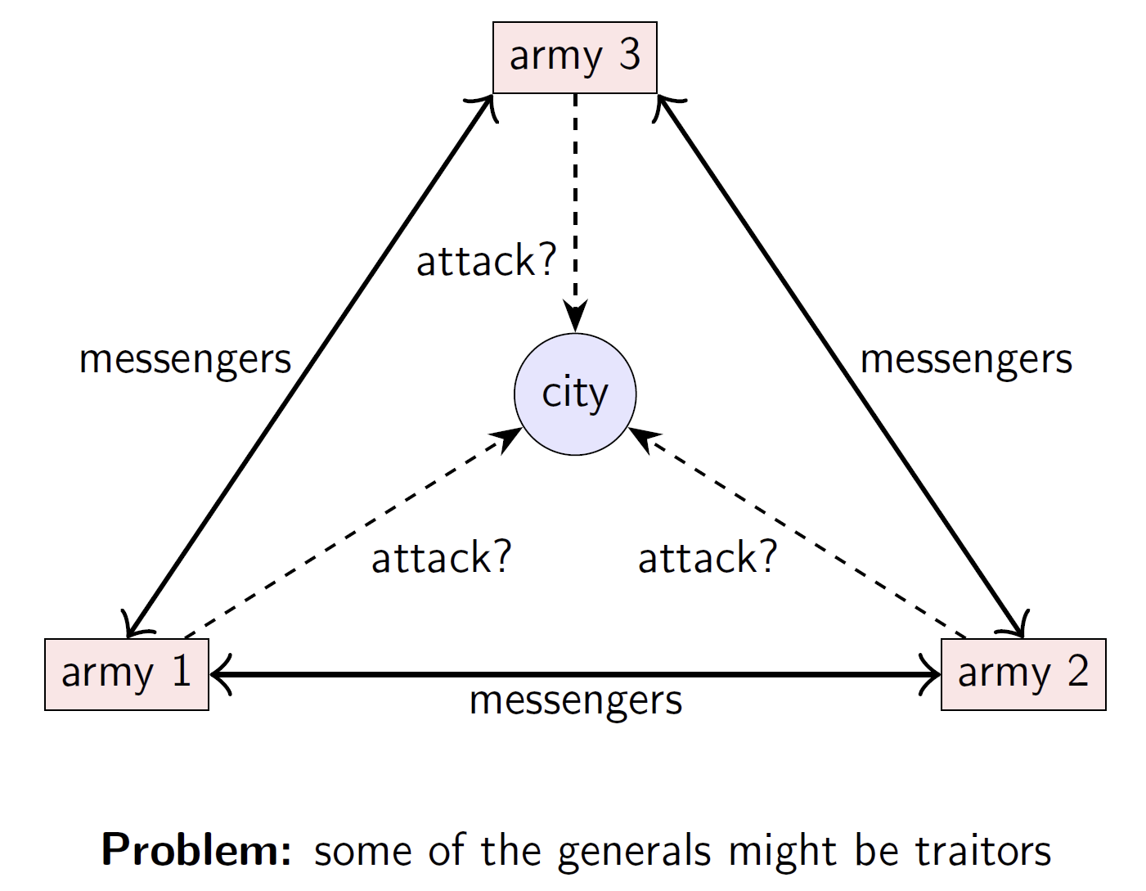
The Byzantine Generals Problem
Victory = all honest generals attack.

Slide 6
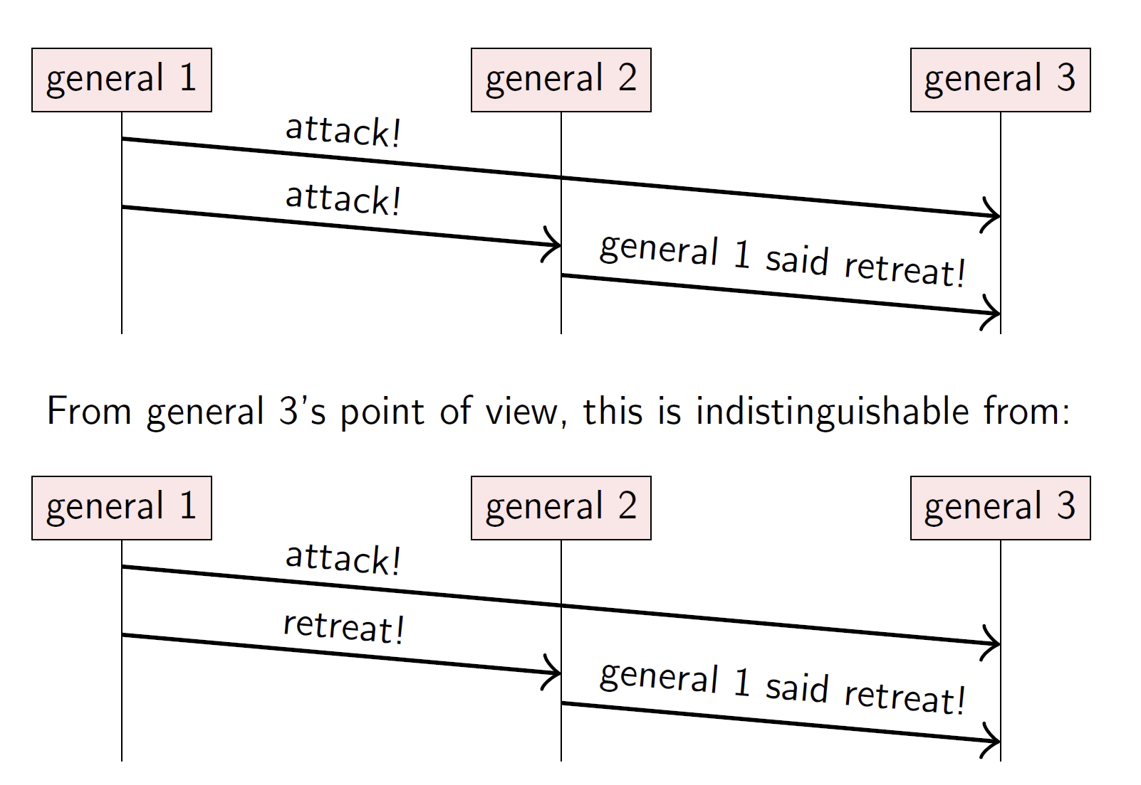
Generals that might lie
It is impossible to specify what the malicious generals are going to do, so the best we can manage is to get the honest generals to agree.

Slide 7
The Byzantine generals problem
Up to f generals might behave maliciously.
Honest generals don’t know who the malicious ones are.
The malicious generals may collude.
Nevertheless, honest generals must agree on plan.
Theorem: need 3f + 1 generals in total to tolerate f malicious generals (i.e. < 1/3 may be malicious)
Cryptography (digital signatures) helps – but problem remains hard

Slide 8
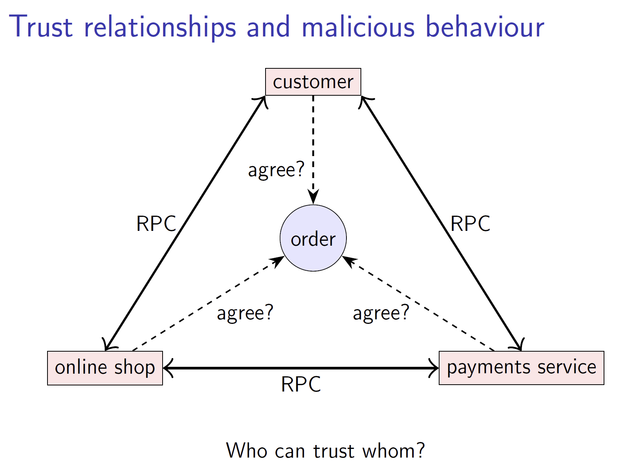
The Byzantine generals problem applied
Real distributed systems do often involve complex trust relationships.

Slide 9

Thank You & See You Again

